Slide 1
A Simple Bayesian Game Prediction Model
By: Jake Flancer
Notes:
Introduce Self

Slide 2
The Motivation
Quantify Team Performance With Uncertainty Estimates Using Limited Data

Slide 3
Bayesian Statistics
Incorporating beliefs not “in” data
Prior “padding” data + Observed data = Estimate
Parameters under uncertainty

Slide 4
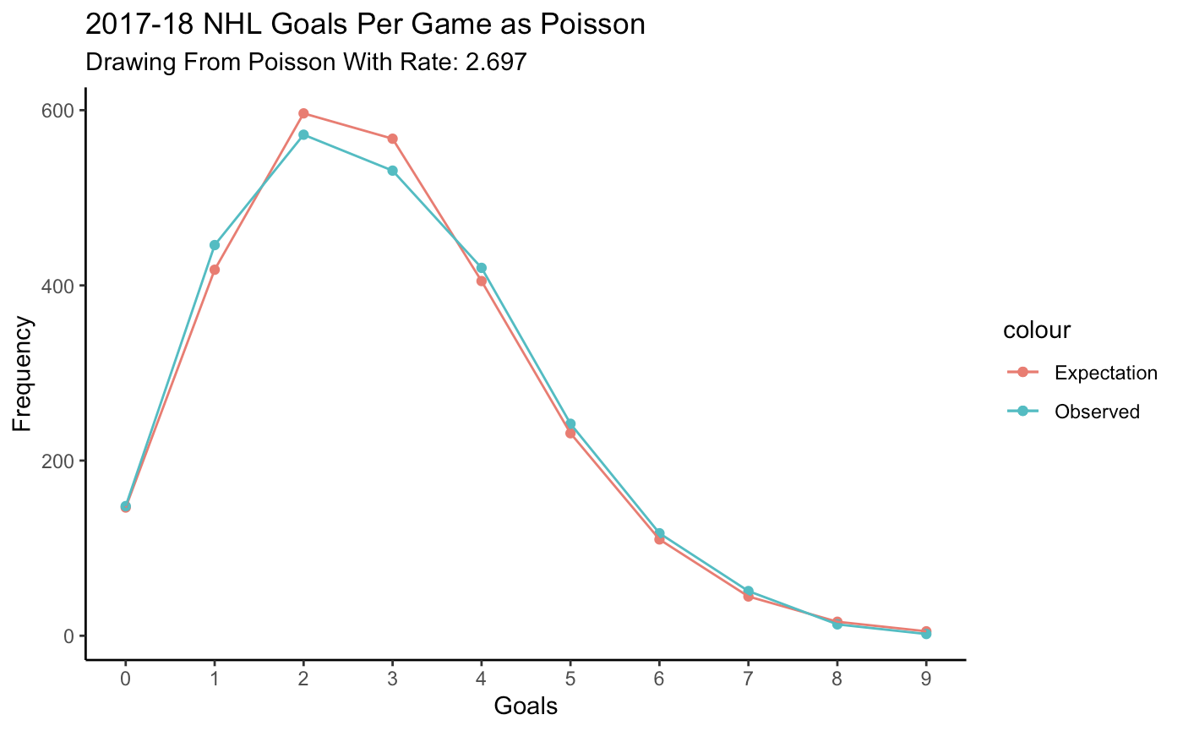
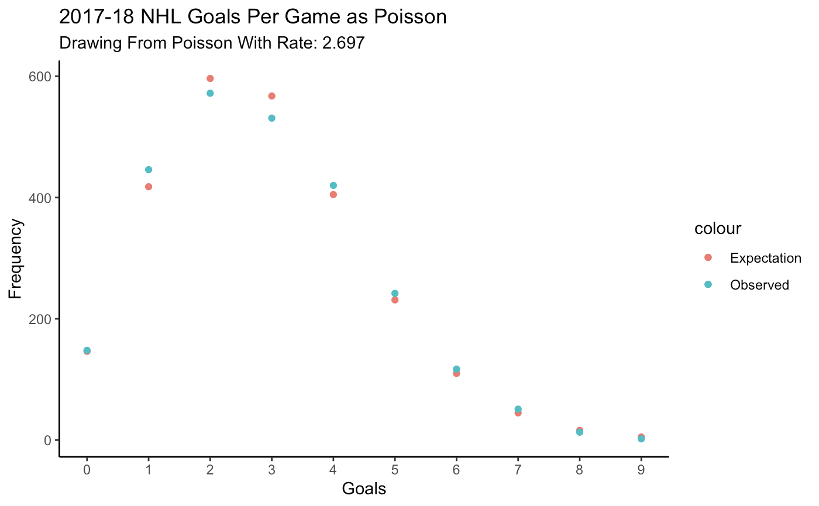
Using the Poisson Distribution
Notes:
Discrete!
Probability Number of Events in a fixed time interval

Slide 5
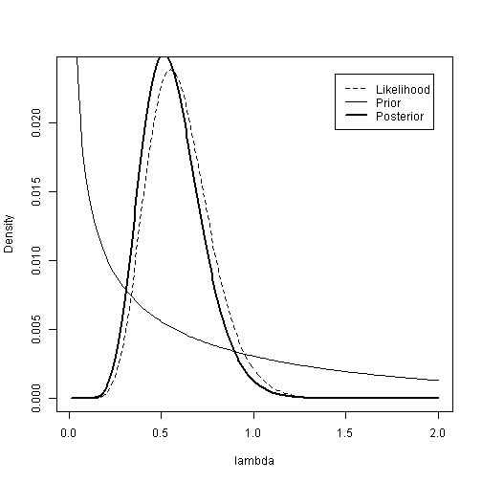
Poisson-Gamma Conjugacy
Prior: Gamma(𝛂, 𝜷)
Data: Goals Scored = Poisson
Posterior: Gamma(𝛂+Goals, 𝜷+GP)
https://www4.stat.ncsu.edu/~reich/st590/code/PoissonGamma

Slide 6
How does this help?
Team A: 1 Game / 5 Goals Scored
Team B: 50 Games / 250 Goals Scored
Which team is better at scoring?

Slide 7
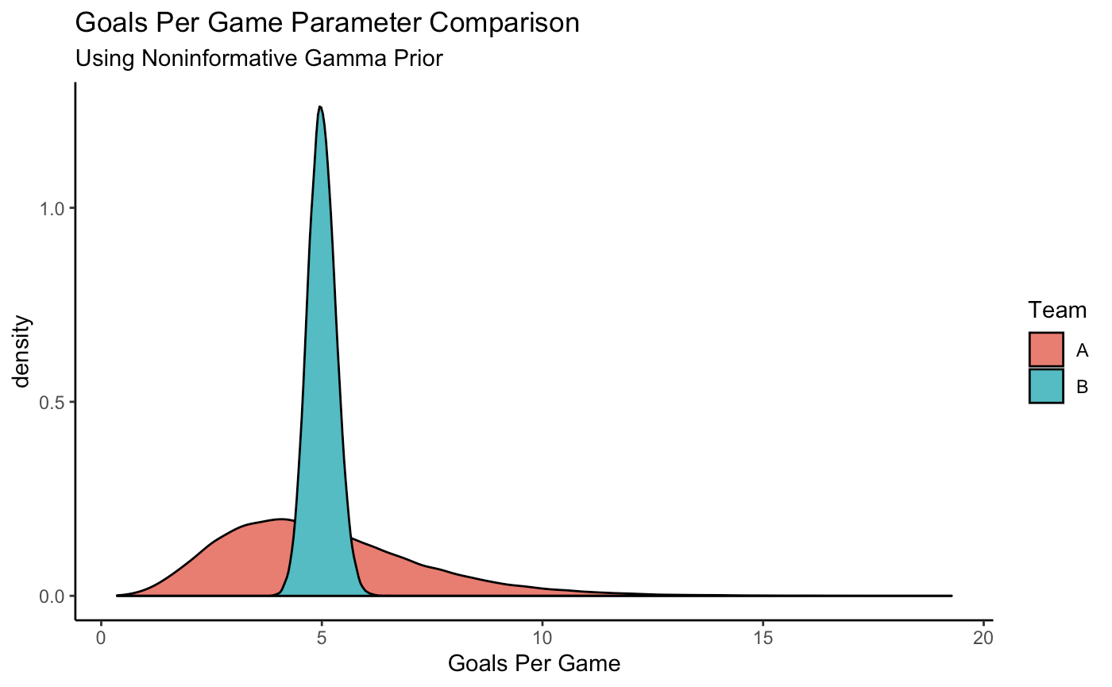
How does this help?

Slide 8
Translating to Hockey...
Using two team specific parameters
Goals For Per Game (GF Rate)
Goals Against Per Game (GA Rate)
Notes:
**Consider Deleting

Slide 9
Prior Distribution
Gamma(“Prior GF”, “Prior GP”)
Previous Season Regressed to League Average
20 Games of “Padding”
Notes:
**Consider Deleting

Slide 10
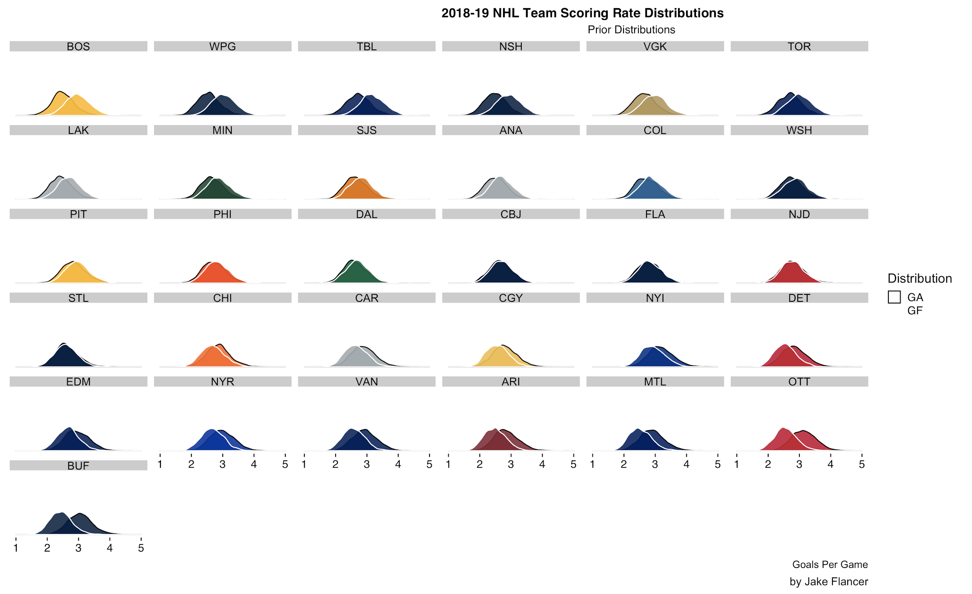
Prior Distribution

Slide 11
Posterior Distribution
Gamma(“Prior GF” + Cumulative GF, “Prior GP” + Total GP)
Game 0 (Prior): Gamma(60 + 0, 20 + 0)
Game 10: Gamma(60 + 30, 20 + 10)
...
Game 82: Gamma(60 + 246, 20 + 82)

Slide 12
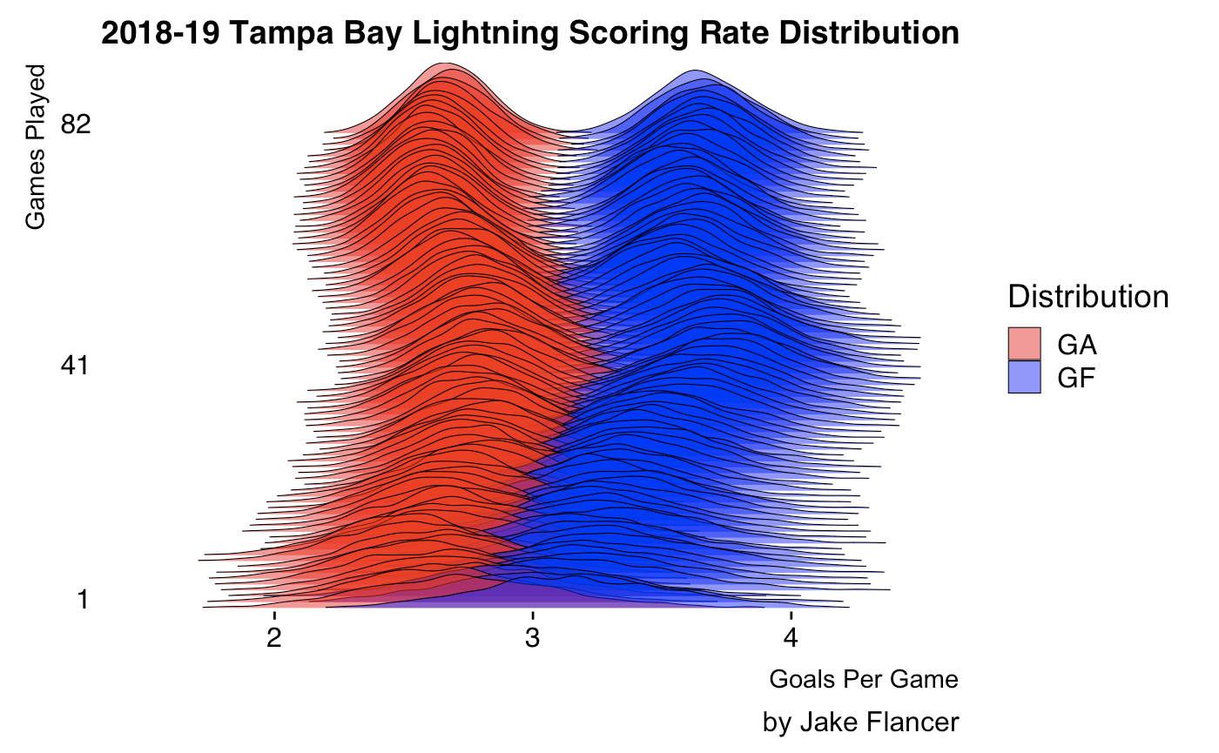
Posterior Distribution
Notes:
Two Features:
Distribution and Direction
Starts really spread out and uncertain, gets more certain as the season progresses
The distribution also “moves” left and right depending on the results of specific games

Slide 13
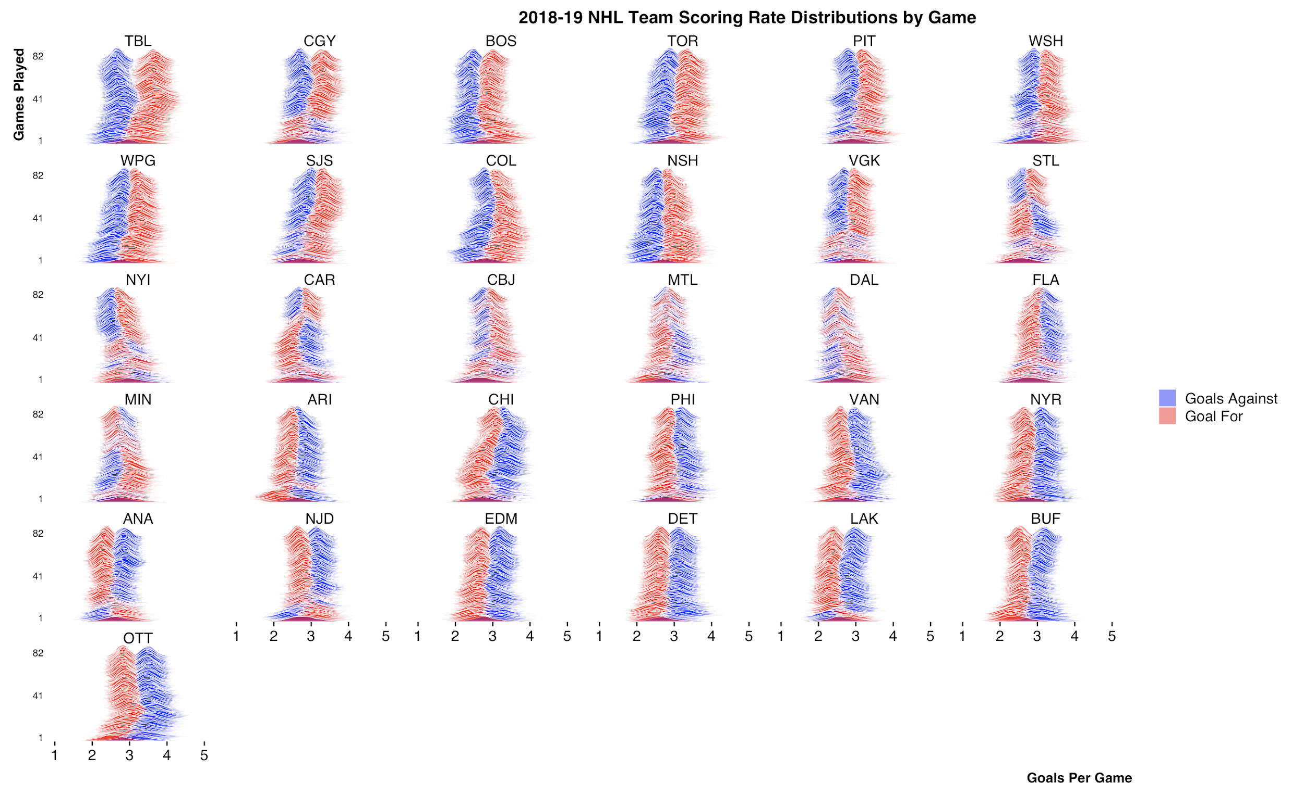
Posterior Distribution

Slide 14
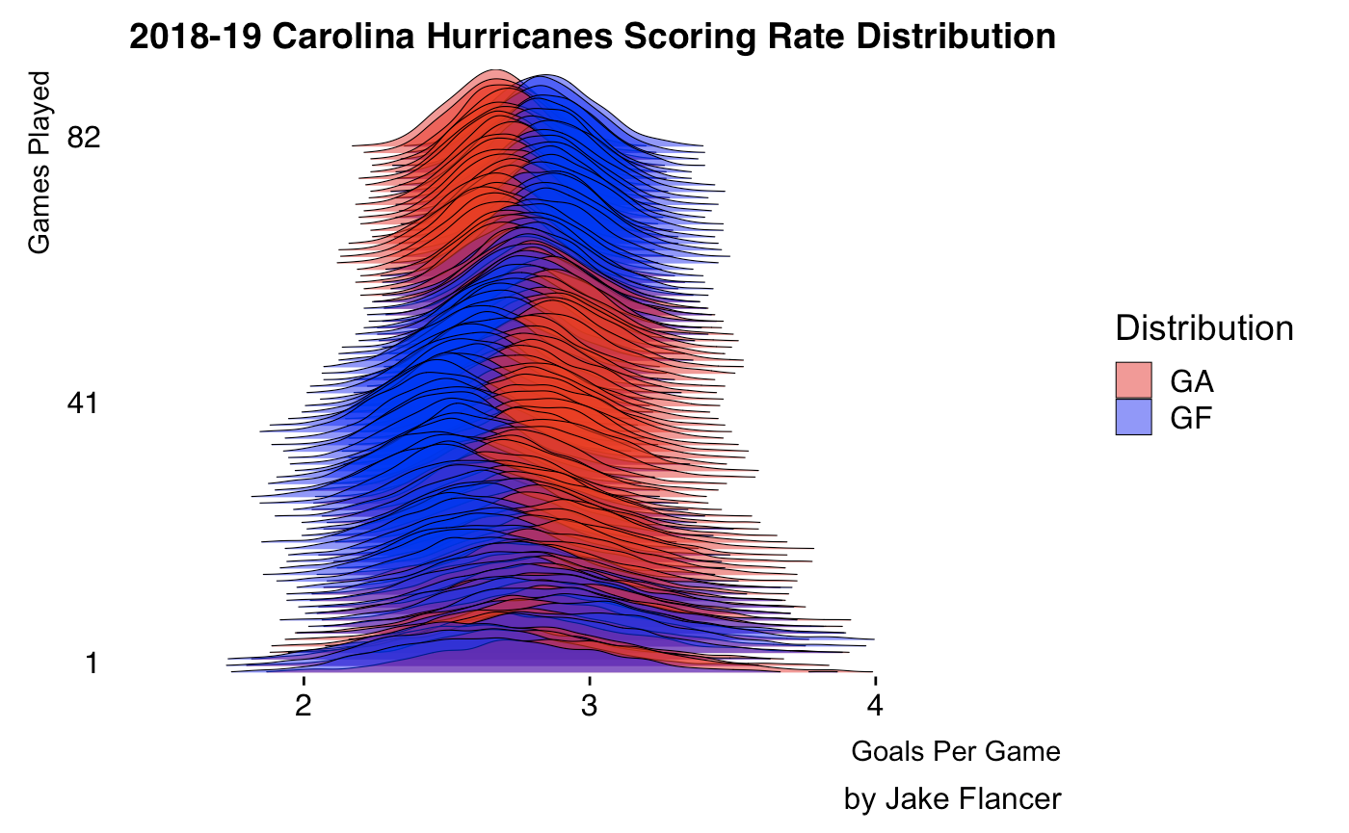
Posterior Distribution

Slide 15
Prior Distribution

Slide 16
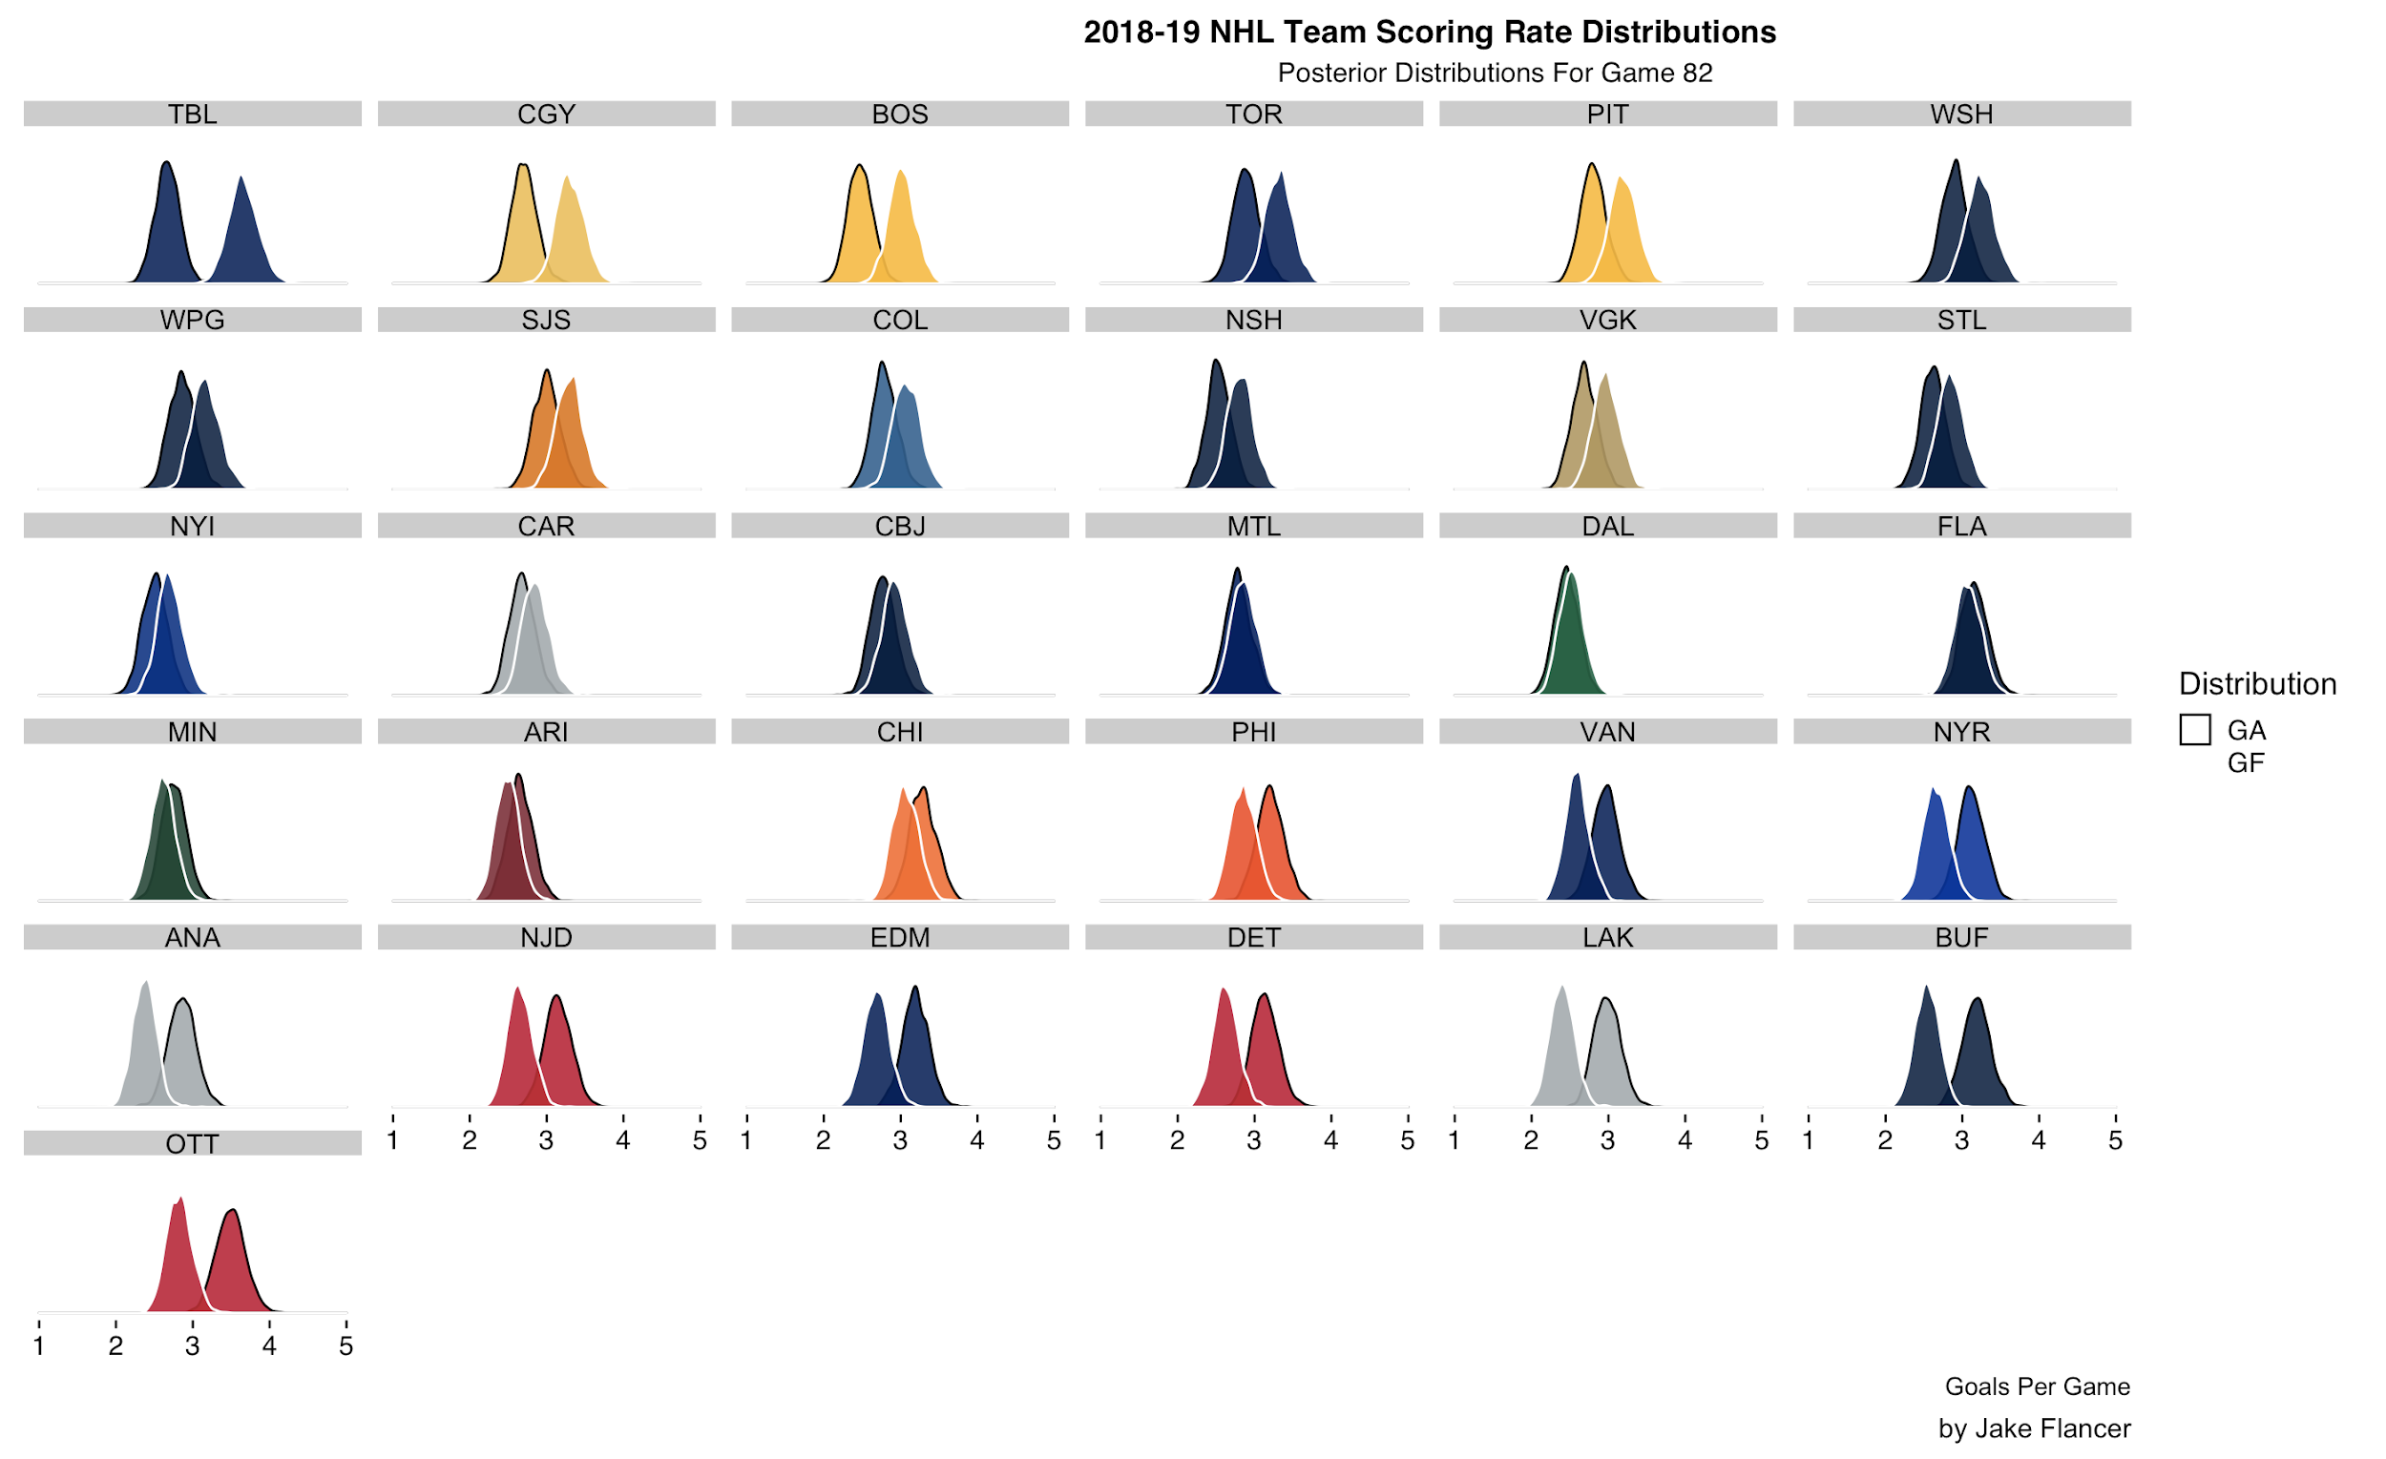
Posterior Distribution

Slide 17
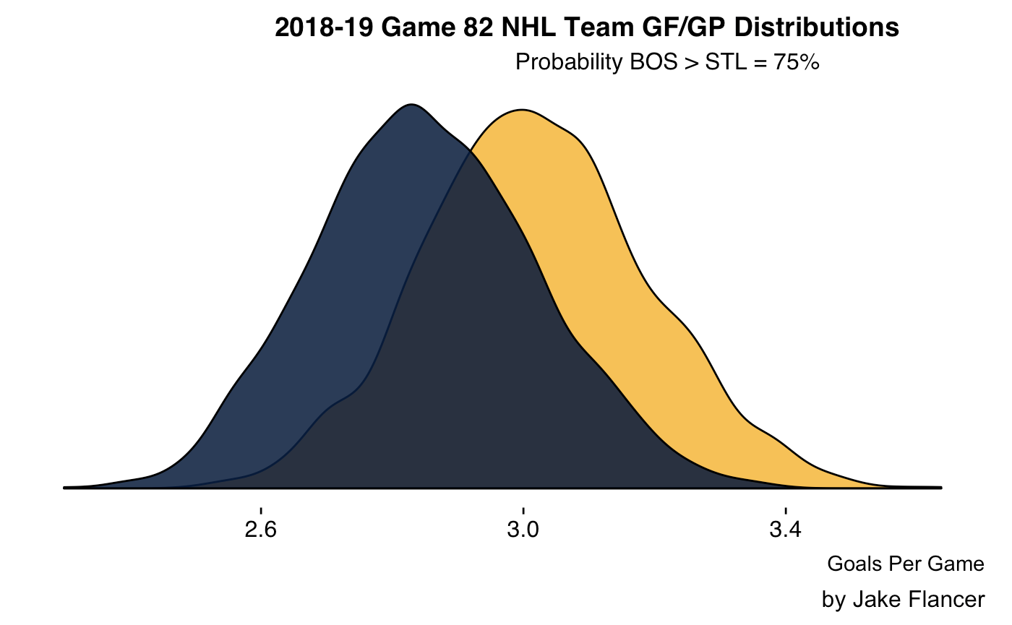
Interpreting the Posterior

Slide 18
Current
Posterior only yields P(Team A > Team B)
Make probability statements about team parameters
“The distribution of the expectation”

Slide 19
Goal
Estimate Game Outcomes
“The distribution of the outcomes”

Slide 20
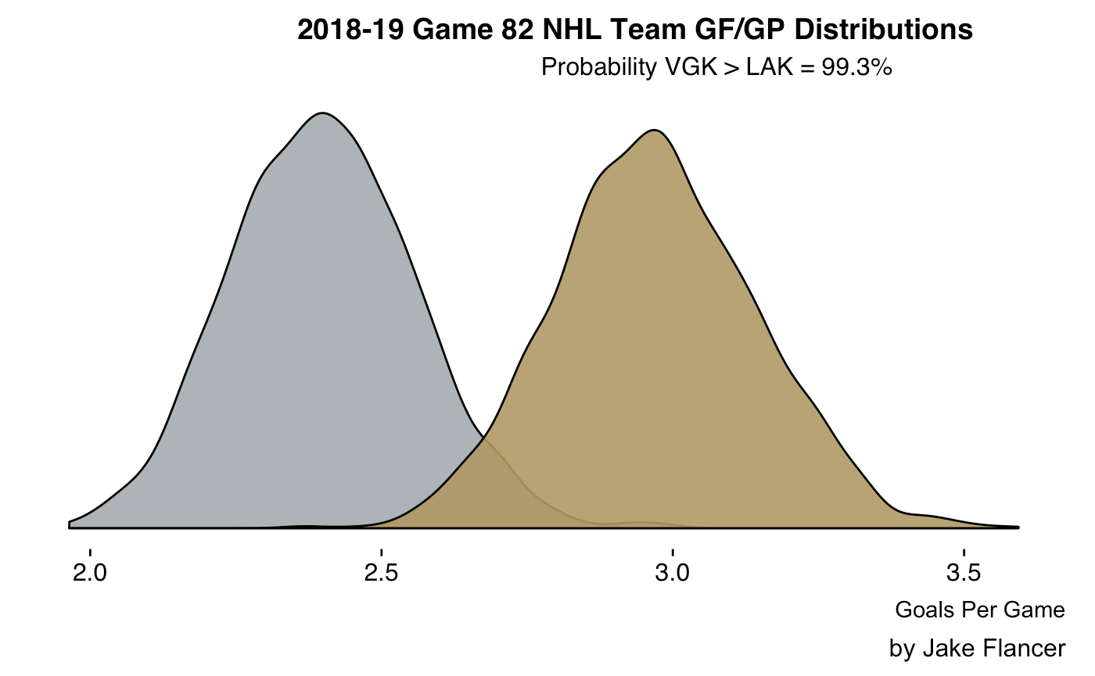
Game Prediction

Slide 21
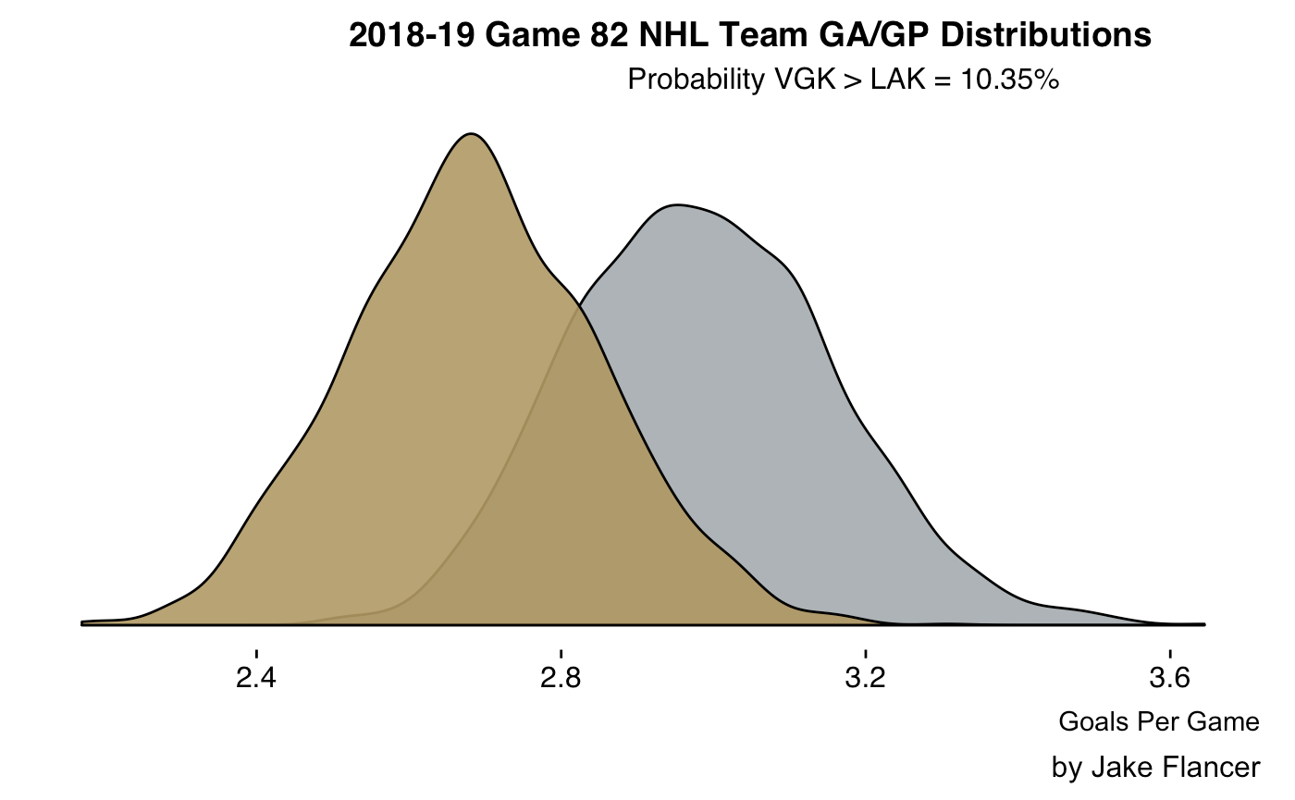
Game Prediction

Slide 22
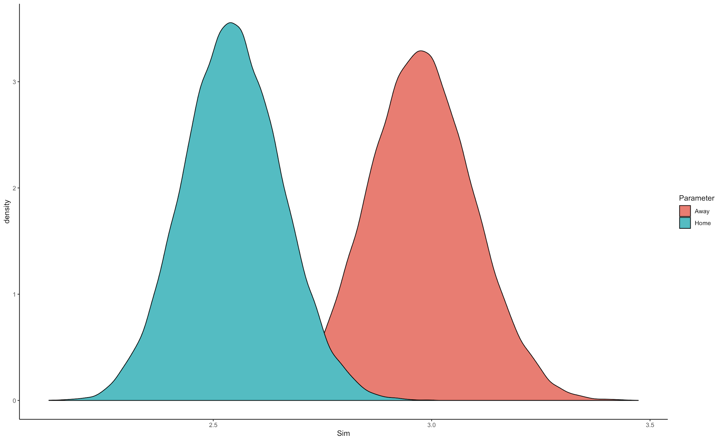
Game Prediction

Slide 23
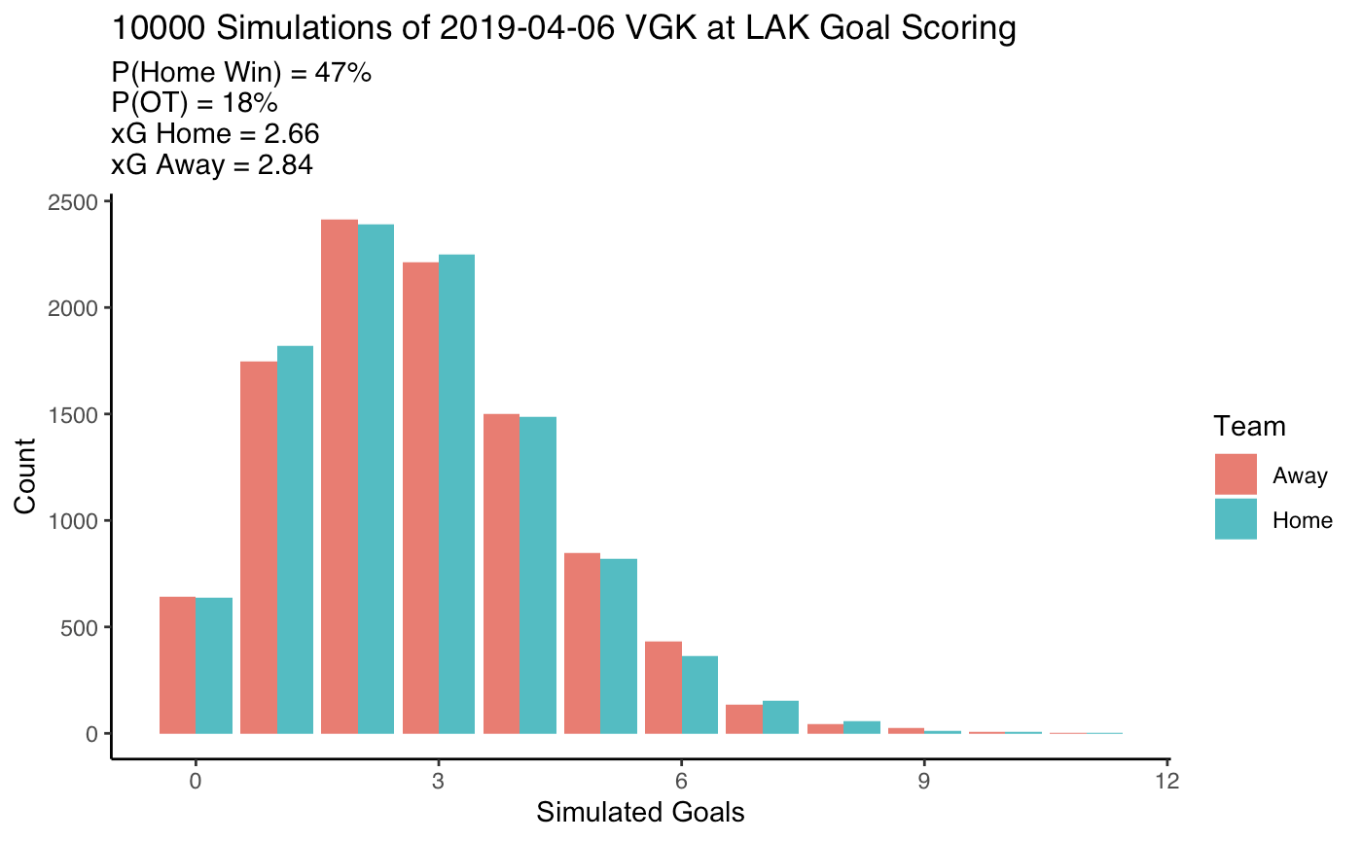
Game Prediction
*Home Advantage Added

Slide 24
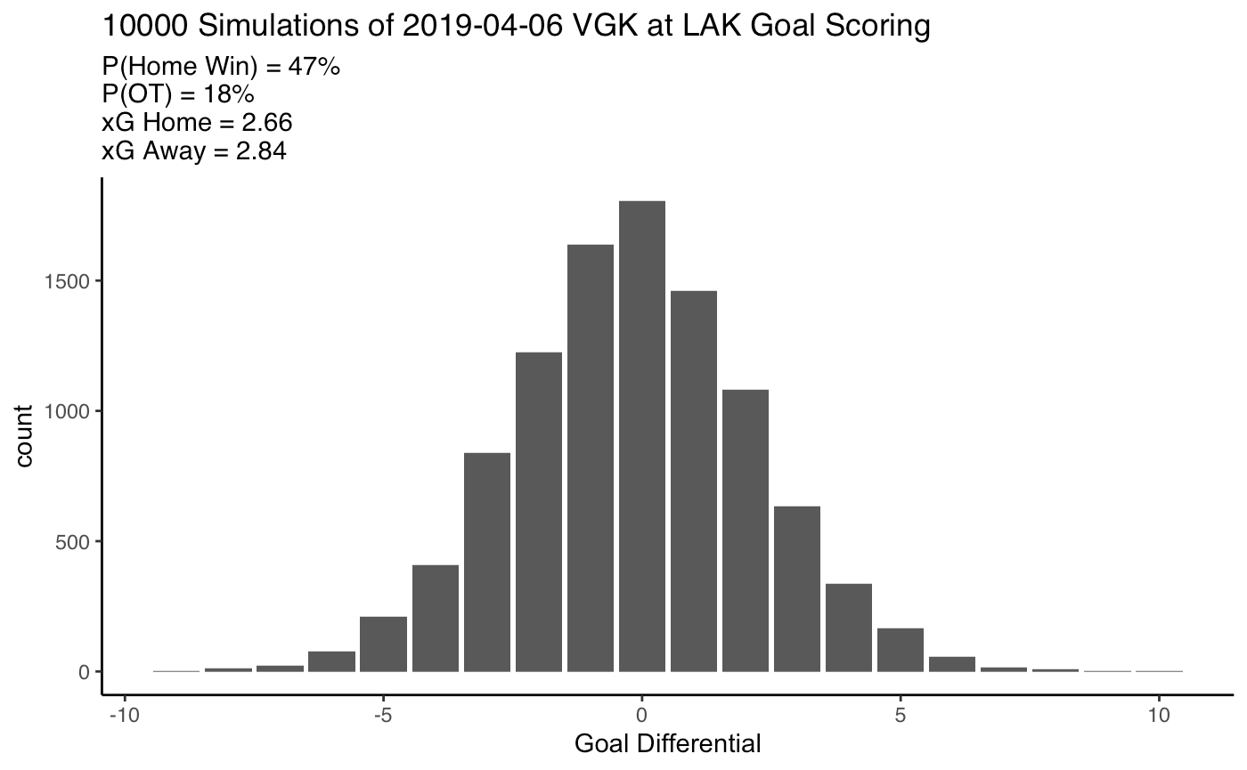
Game Prediction

Slide 25
Key Assumptions and Issues
Goal scoring is not truly poisson (score effects)
16% in OT, reality is 21%
Parameters equally weighted
Team strength stays the same (game 1 and game 82 equally weighted)
Notes:
**Consider Deleting

Slide 26
In Summary
Team level uncertainty estimates
Make straightforward probabilistic team comparisons
Game outcome distributions
Works with limited data
Cool plots!

Slide 27
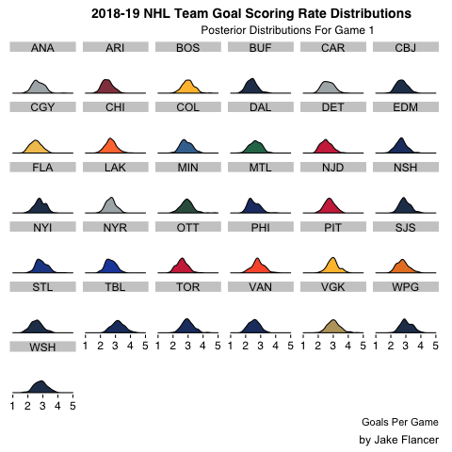
Thank You!
Feel Free To Reach Out
jflancer@wharton.upenn.edu
@jakef1873
github.com/jflancer/gameModel
Use even-strength.com!!!

Slide 28
Appendix
Data via nhl.com
“Full” Presentation (w/ math): https://tinyurl.com/RITgamemodel

